Slide 1

ASP.NET Core Web App (Model – View – Controller)
Sparta Global Trainee Tracker

Slide 2
The Dev Team
Matthew Handley Project Management
Philip Thomas
Overview and Technology Stack
Ahmed Idris
API Controller Implementation
Nooreen Kasim Ali Service Layer Implementation
Danyal Saleh
View Model Implementation
Daniel Manu
Unit Testing

Slide 3
Project Deliverables
ASP.NET MVC Web Application Application
Up to date project board
High quality user stories and acceptance criteria written in Gherkin
Gherkin scenarios that represent the user journeys
A README file which includes:
Project objectives
Set up guide for test framework
Test suite
Collaborative use of GitHub

Slide 4
Project Requirements
Minimum Viable Product (MVP)
Trainees can update their trainee tracker weekly
Trainers can view the trainee tracker
Trainees can edit, delete and create trackers for themselves
The web app should have at least one controller and one service
Controller functionality should be verified using mock tests
Roadmap
Graphs or charts
Filtering e.g., by course or trainee profiles
Additional roles

Slide 5
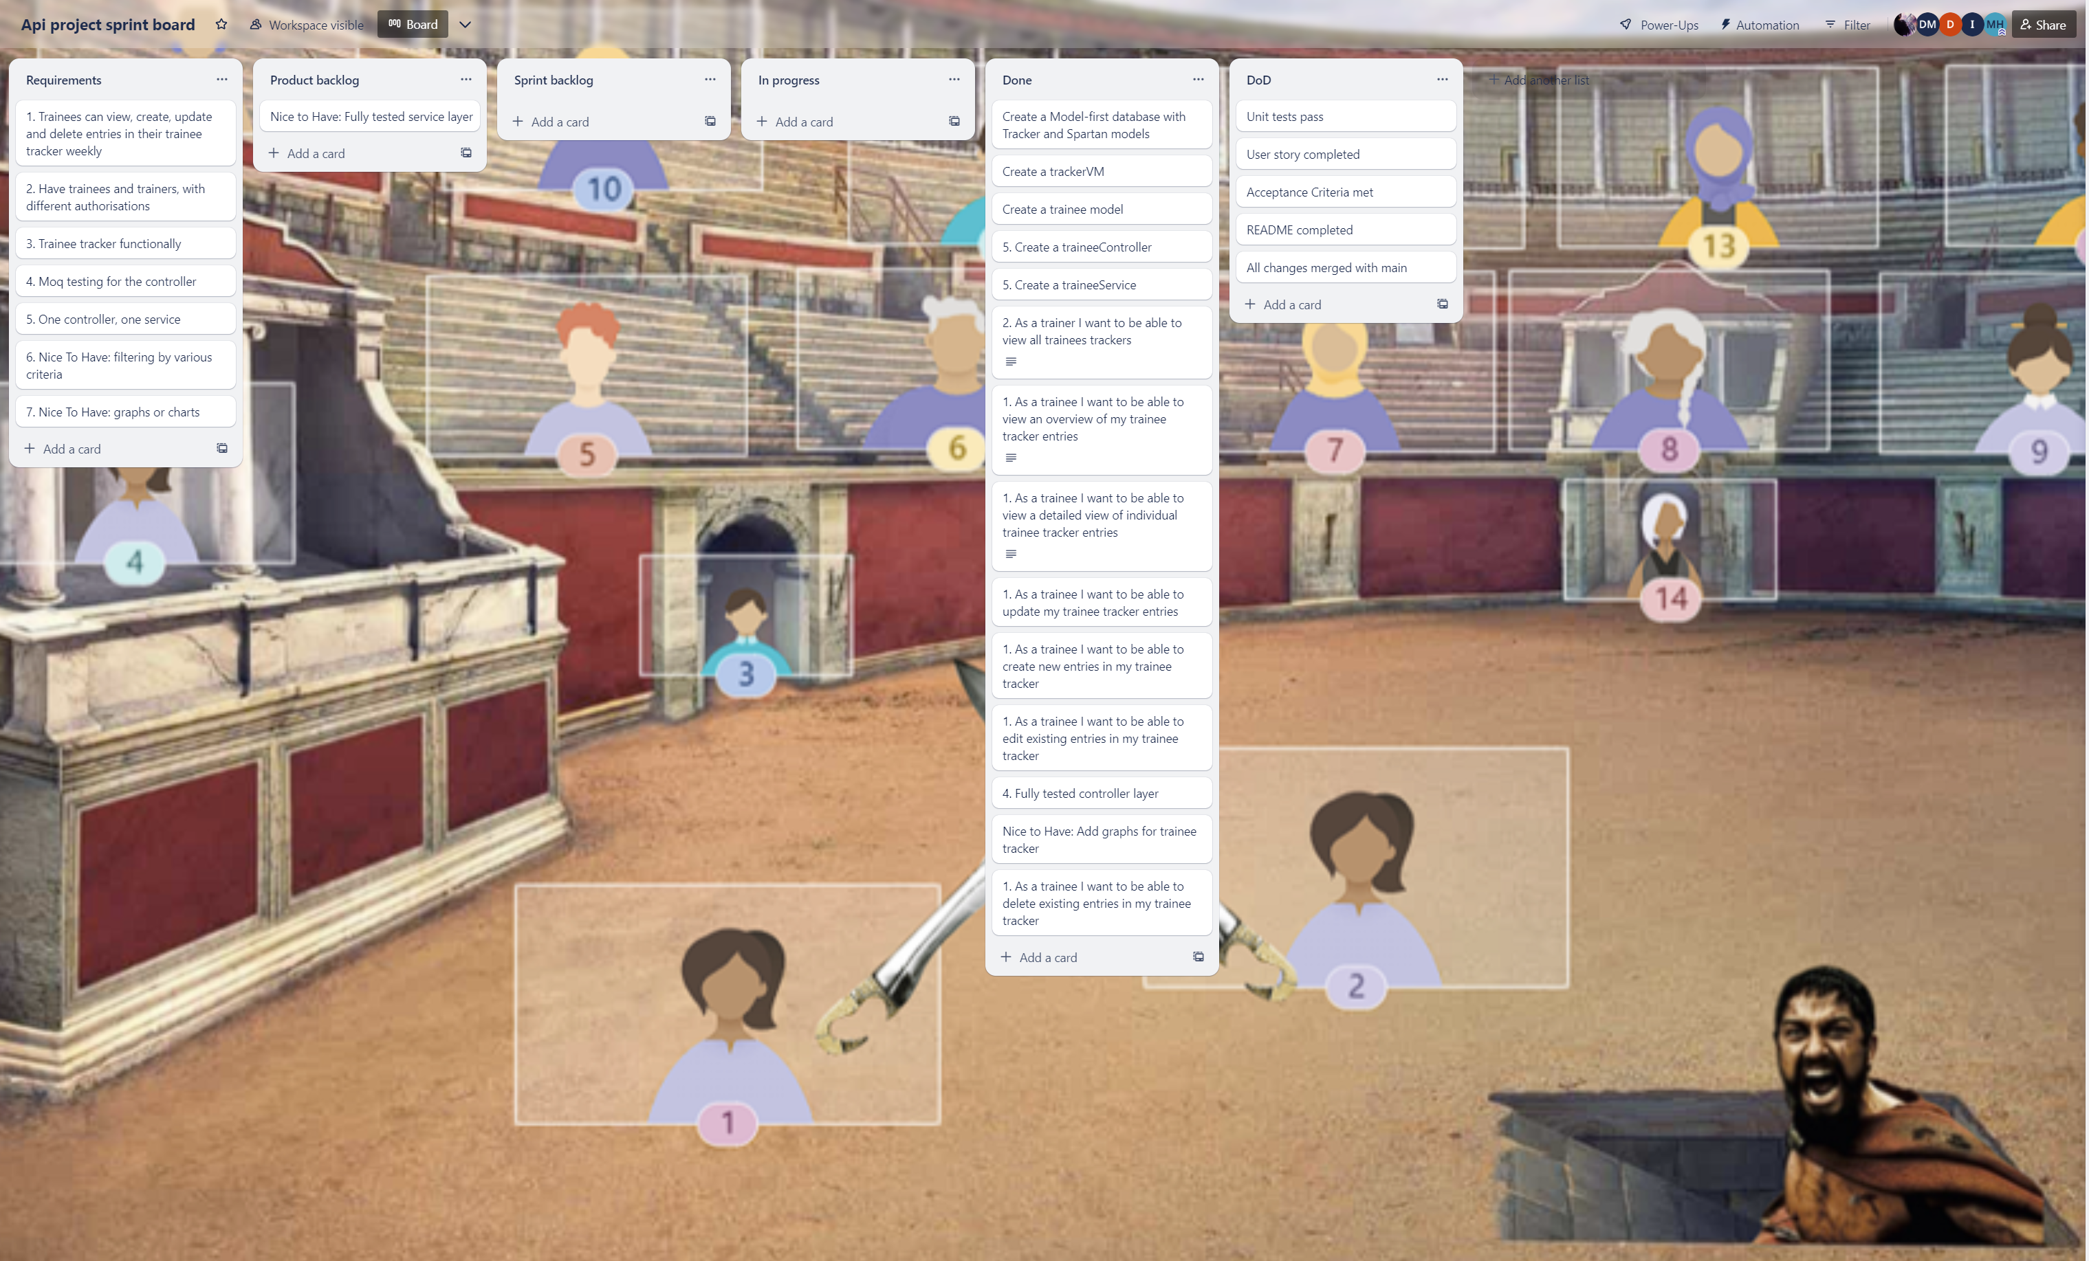
Project Management
Used Agile/Scrum methodology and Trello to manage tasks and workflow
Used Git and Github for source control
Used a combination of mob programming and pair programming to complete user stories
Used MetroRetro for conducting retrospective

Slide 6
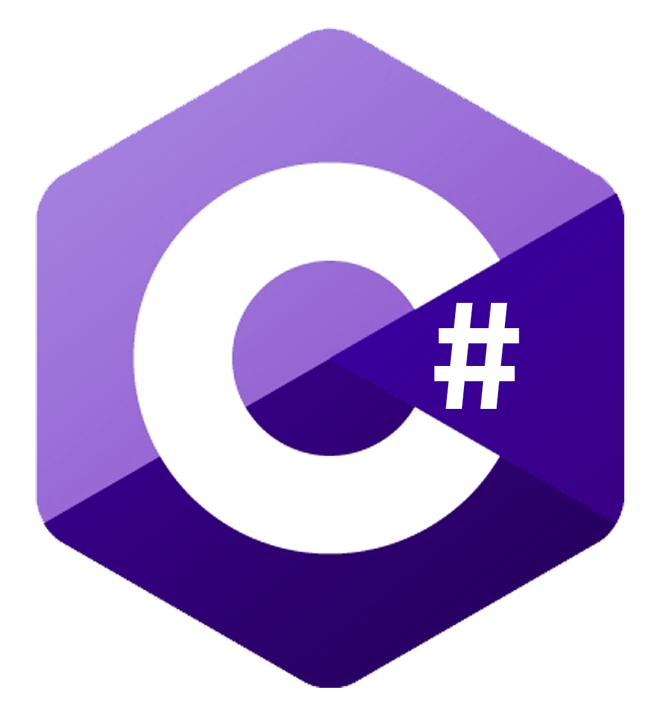
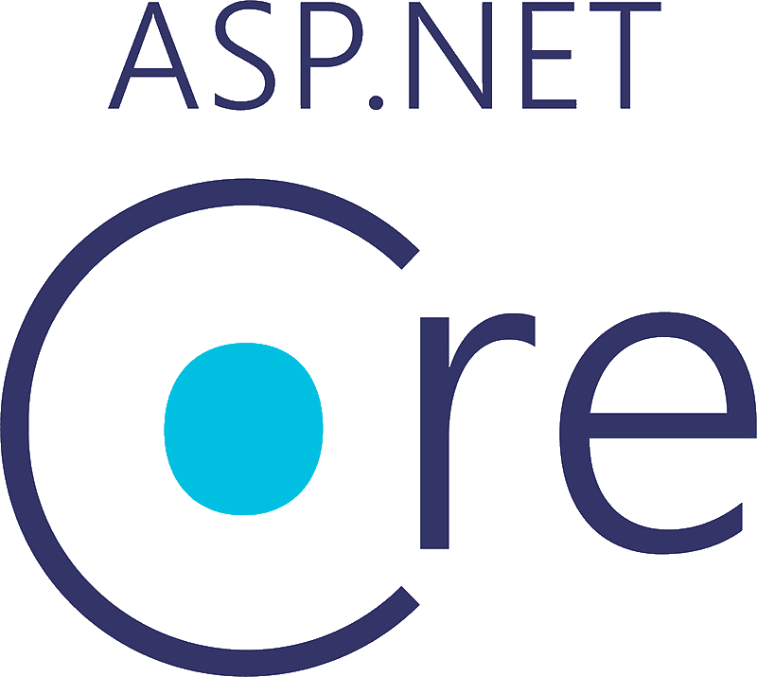
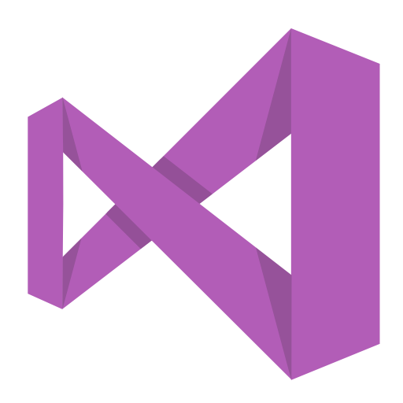
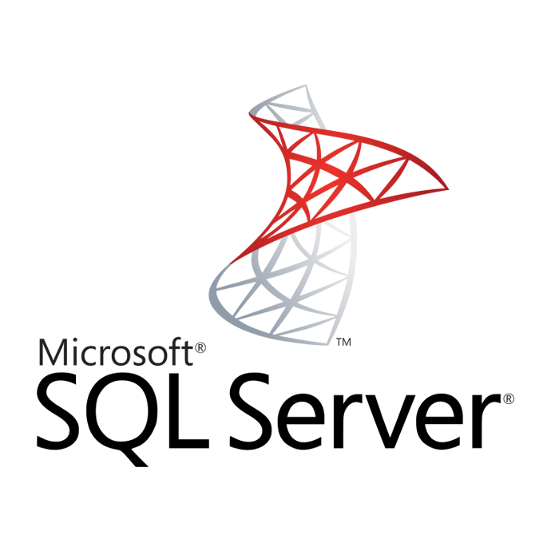
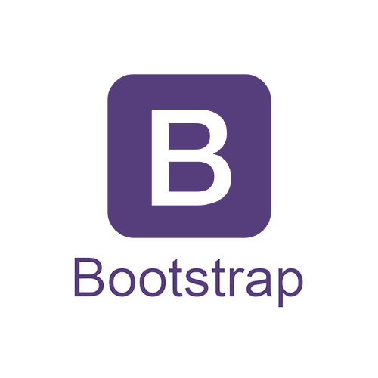
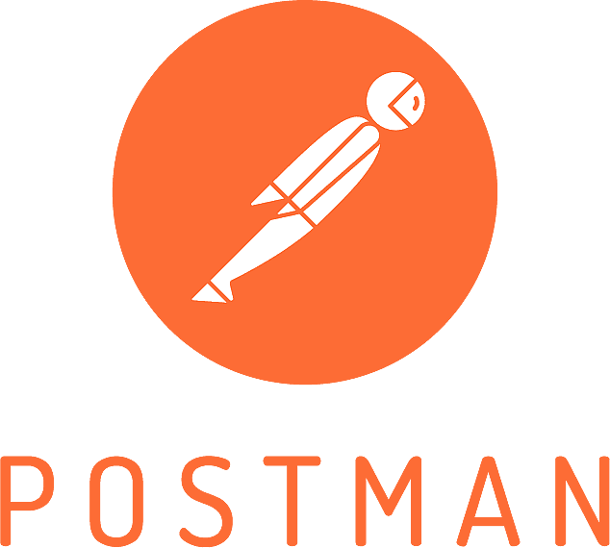

Technology Stack for Building and Testing an ASP.NET Core Web App
Visual Studio: An IDE for building ASP.NET Core web applications.
C#: An OOP language used in ASP.NET Core development.
ASP.NET Core: A cross-platform web development framework
HTML5: Used for structuring and presenting content on the web.
Bootstrap: A popular front-end framework that provides a collection of pre-built CSS styles and JavaScript components.
SQL Server Express 2019 LocalDB: A lightweight, local database solution.
Entity Framework Core: An ORM framework that simplifies database access in ASP.NET Core applications.
AutoMapper: A library that simplifies object-to-object mapping in .NET applications.
NUnit Framework: A unit testing framework for .NET applications.
Moq Framework: A mocking framework for .NET applications.
Postman: An API development and testing tool that simplifies the process of making HTTP requests and testing APIs.

Slide 7
Set up
Dependencies
DbContext
Migration
Controller
Views
Service Layer
Validation Logic
Unit Testing
Authentication and Authorization

Slide 8
Code Demo
Ahmed Idris
API Controller Implementation
Nooreen Kasim Ali Service Layer Implementation
Danyal Saleh
View Model Implementation
Daniel Manu
Unit Testing

Slide 9
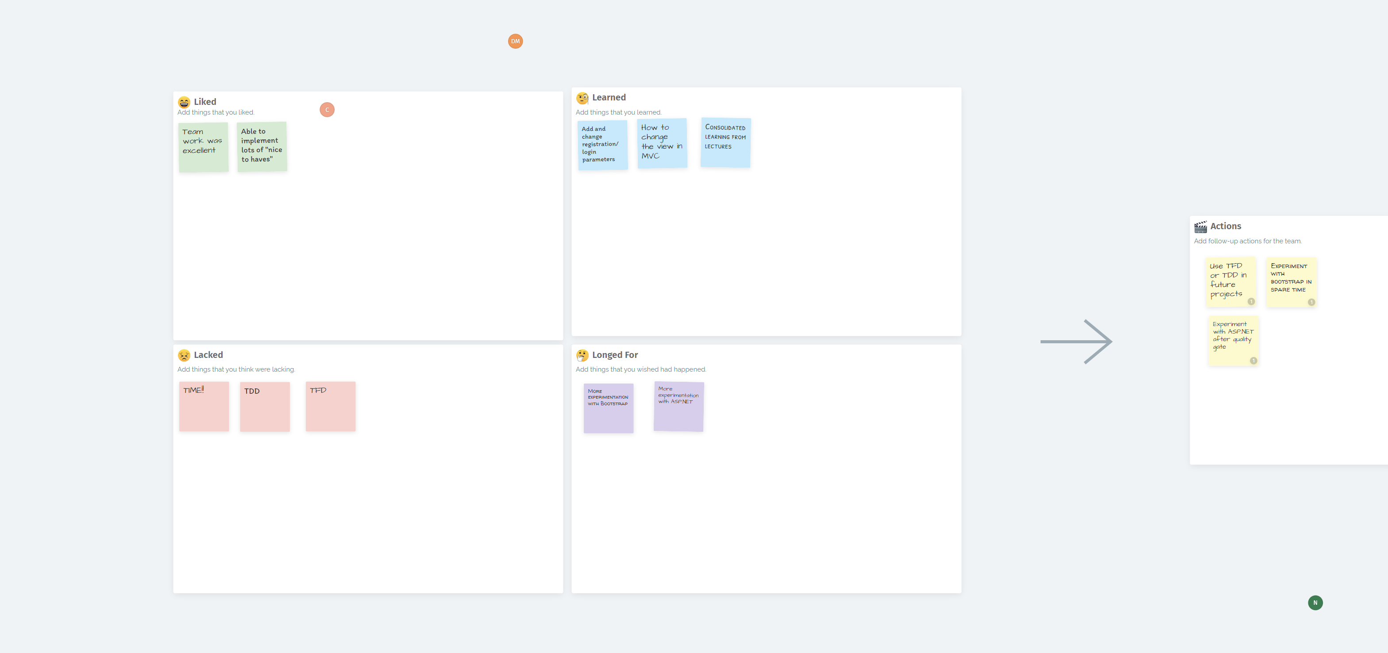
Metrospective

Slide 10

Thank you for listening!

